Slide 1


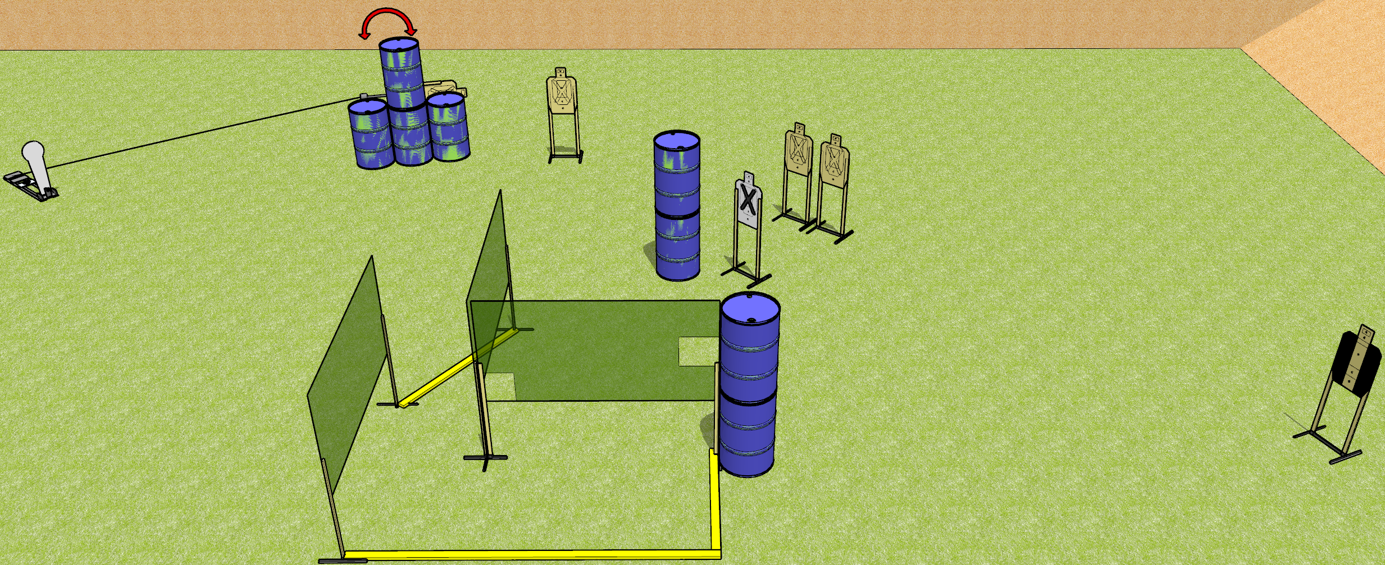
 | Dothan Gun Club – USPSA Match Ride the Lightning Course Designer : Drew Coleman
START POSITION : Standing anywhere outside the shooting area, wrists below belt
GUN READY CONDITION : Pistol loaded and holstered. PCC loaded, buttstock on belt, safety on. |  | SCORING: Comstock, 11 rounds TARGETS: 5 paper, 1 Steel SCORED HITS: Best 2 on paper, steel until down START-STOP: Audible, last shot RULES:
STAGE PROCEDURE: Engage targets as they become available from within the fault lines.

Slide 2
Ride the Lightning
Written Stage Briefing
Ride the Lightning is an 11 round, 55 point, Comstock short course. There are five USPSA targets and one Colt popper. The best two hits on paper will score, and steel must fall to score. The start signal is audible.
Handgun start position is standing anywhere outside the shooting area, wrists relaxed at sides. Handgun is loaded and holstered.
PCC start position is standing anywhere outside the shooting area, buttstock on belt. Carbine is loaded, safety on, held with both hands.
Upon start signal, engage targets as they become available from within the shooting area. The swinger is activated by the Colt popper.

